Slide 1
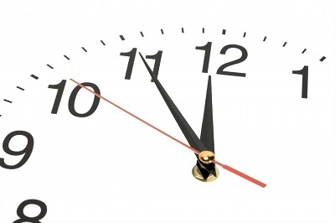
TOPIC 3
Decisions Over Time
SECTION 1
The Single-Person Decision Problem
Games
TOPIC 1
The Rational Choice Paradigm
Class 8
TOPIC 2
The Expected Utility Theory
Static Structure
(One-time)
Sequential Decision-making
(Multiple decisions, one after another)

Slide 2

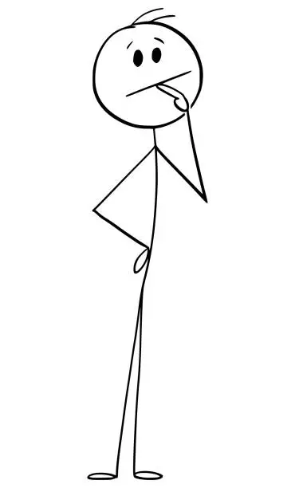


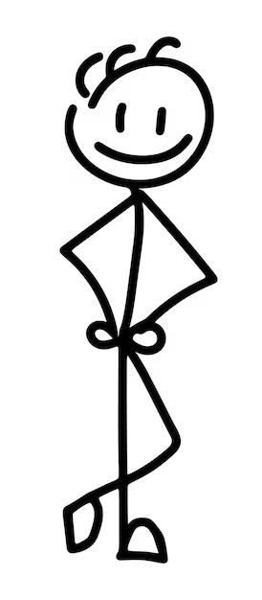



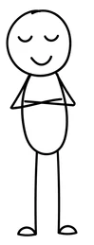



Eat or Be Eaten: A Game of Survival
Mr. Snack, the Lost Sailor
Who will end up eating him?
S
1
2
3
4
5
6
7
8
9
10
The Ten Cannibals
The Hierarchy
Common knowledge of
Rational

Slide 3
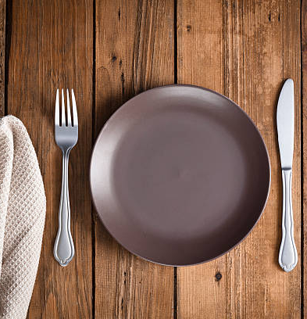
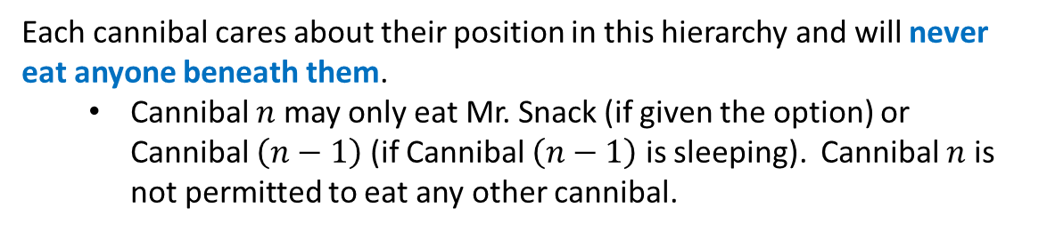
Ten Hungry Cannibals
Mr. Snack, the Lost Sailor, is stranded on an island with 10 rational cannibals.
The cannibals are ranked in a hierarchy of dominance, with Cannibal 1 being the most dominant, followed by Cannibal 2, and so on, down to Cannibal 10.
The cannibals take turns deciding whether to eat Mr. Snack, starting with Cannibal 1, who gets first dibs.
Each cannibal cares about their position in this hierarchy and will never eat anyone beneath them.
  Cannibal $n$ may only eat Mr. Snack (if given the option) or Cannibal $\left(n−1\right)$ (if Cannibal $\left(n−1\right)$ is sleeping). Cannibal $n$ is not permitted to eat any other cannibal.
If a cannibal eats, they will fall asleep, making them vulnerable to the next cannibal in line.
Who will dine?

Slide 4

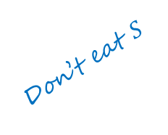







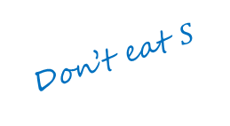
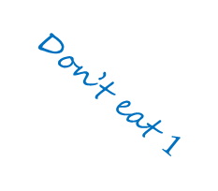




Game Tree
Decision
If a cannibal eats, they will fall asleep, making them vulnerable to the next cannibal in line.
$$1$$
Don’t eat $S$
Eat $S$
The cannibals take turns deciding whether to eat Mr. Snack, starting with Cannibal 1, who gets first dibs.
$$2$$
$$2$$
Don’t eat $S$
Eat $1$
Don’t eat $1$
Eat $S$
$$3$$
$$3$$
$$3$$
Terminal node
Eat $S$?
Eat $2$?
Eat $2$?

Slide 5








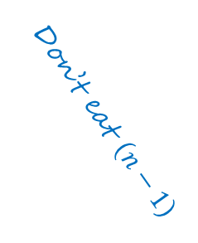
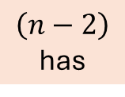
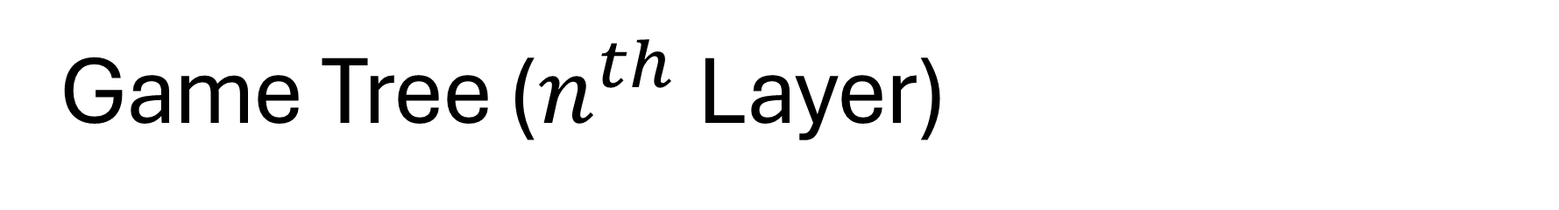
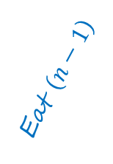

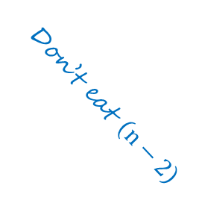



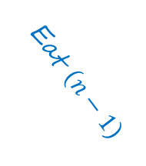

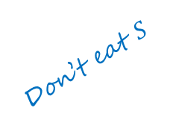



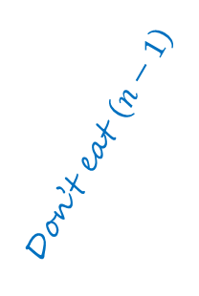

Game Tree ($n^{th}$ Layer)
$\left(n−2\right)$ has
Not eaten $S$
Not eaten $\left(n−3\right)$
$E$aten $S$
Eaten $\left(n−3\right)$
Terminal node
$$n−1$$
$$n−1$$
Don’t eat $S$
Eat $\left(n−2\right)$
Eat $S$
Don’t eat $\left(n−2\right)$
$$n$$
$$n$$
$$n$$
Terminal node
Don’t eat $S$
Eat $S$
Eat $\left(n−1\right)$
Eat $\left(n−1\right)$
Don’t eat $\left(n−1\right)$
Don’t eat $\left(n−1\right)$
$$n+1$$
$$n+1$$
$$n+1$$
$$n+1$$
Terminal node
Terminal node

Slide 6
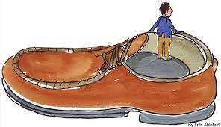




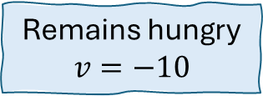
Cannibal 1
Rational
Maximize Payoffs
$$1$$
Don’t eat $S$
Eat $S$
Remains hungry
$$v=−10$$
Satisfies hunger.
Sleeps & gets eaten by $2$
$$v=−∞$$
Cannibal $1$ won’t eat Mr. Snack because then Cannibal $2$ will eat him.

Slide 7


Cannibal 2
$$2$$
Don’t eat $S$
Eat $S$
Remains hungry
$$v=−10$$
Satisfies hunger.
Sleeps & gets eaten by $3$
$$v=−∞$$
Cannibal $2$ won’t eat Mr. Snack because then Cannibal $3$ will eat him.
Cannibals 3, 4, 5, 6, 7, 8, & 9 won’t eat Mr. Snack

Slide 8


Cannibal 10
$$10$$
Don’t eat $S$
Eat $S$
Remains hungry
$$v=−10$$
Satisfies hunger.
Sleeps, but survives
$$v=+10$$
Mr. Snack will be eaten by Cannibal 10!
What’s wrong with this line of thinking?

Slide 9
Forward reasoning
Decisions Made with Incomplete Information about future decisions
Sequential Decision Making
$$1$$
Don’t eat $S$
Eat $S$
Remains hungry
$$v=−10$$
Satisfies hunger.
Sleeps & gets eaten by $2$
$$v=−∞$$
Cannibal $1$ won’t eat Mr. Snack because then Cannibal $2$ will eat him.
This is an assumption about a decision that will be made in the future (What Cannibal 2 will decide to do)
We can’t conclude this…

Slide 10
Eat or Be Eaten: A Game of Survival
Mr. Snack, the Lost Sailor
Each cannibal must assume what the next in line will do.
Who will end up eating him?
The only cannibal whose outcomes are certain
S
Lack of knowledge about future decisions means no cannibal’s decision is based on certainty
1
2
3
4
5
6
7
8
9
10
The Ten Cannibals
The Hierarchy
Common knowledge of
Rational

Slide 11
Backward Induction
Payoffs are assigned only to final actions.
Hence, comparisons are possible only at the end of the decision tree.
The decision problem asks which initial action should be chosen.
Payoffs are not assigned directly to initial actions.
Backward induction bridges this gap by working backward from payoff-comparable final actions to earlier choices that lack direct payoff comparisons.

Slide 12
Cannibal 10
$$10$$
Don’t eat $S$
Eat $S$
Remains hungry
$$v=−10$$
Satisfies hunger.
Sleeps, but survives
$$v=+10$$
or Cannibal 9
Cannibal $10$ will eat Mr. Snack, if given the option.
We can conclude this…
This is not an assumption made due to lack of knowledge about future decisions

Slide 13


Cannibal 9
Common Knowledge of Rationality: Cannibal $9$ knows that Cannibal $10$ is rational.
Cannibal | Eat or Not?
10 | Eat
9 | Won’t Eat
$$9$$
Don’t eat $S$
Eat $S$
Remains hungry
$$v=−10$$
Satisfies hunger.
Sleeps & gets eaten by $10$
$$v=−∞$$
or Cannibal 8
Cannibal $9$ won’t eat Mr. Snack because then Cannibal $10$ will eat him.
We can conclude this…
This is not an assumption made due to lack of knowledge about future decisions

Slide 14

Cannibal 8
Common Knowledge of Rationality: Cannibal $8$ knows that Cannibal $9$ is rational.
Cannibal | Eat or Not?
10 | Eat
9 | Won’t Eat
8 | Eat
$$8$$
Don’t eat $S$
Eat $S$
Remains hungry
$$v=−10$$
Satisfies hunger.
Sleeps, but survives
$$v=+10$$
Cannibal $8$ will eat Mr. Snack or Cannibal $7$, if given the option, because Cannibal $9$ won’t eat Cannibal $8$.
This is not an assumption
We can conclude this…

Slide 15
Cannibals 7, 6, 5…., 2, 1
BACKWARD INDUCTION
Cannibal 2 makes the frst move in this rational sequence…
Cannibal | Eat or Not?
10 | Eat
9 | Won’t Eat
8 | Eat
7 | Won’t Eat
6 | Eat
5 | Won’t Eat
4 | Eat
3 | Won’t Eat
2 | Eat
1 | Won’t Eat
I can eat without fear because even if I fall asleep, no other cannibal will eat me.
I can't eat Mr. Snack or Cannibal $8$ because if I do, Cannibal $10$ will eat me for sure.
I can eat without fear because even if I fall asleep, Cannibal $9$ will not eat me.
I can't eat Mr. Snack or Cannibal $6$ because if I do, Cannibal $8$ will eat me for sure.
I can eat without fear because even if I fall asleep, Cannibal $7$ will not eat me.
I can't eat Mr. Snack or Cannibal $4$ because if I do, Cannibal $6$ will eat me for sure.
I can eat without fear because even if I fall asleep, Cannibal $5$ will not eat me.
I can't eat Mr. Snack or Cannibal $2$ because if I do, Cannibal $4$ will eat me for sure.
I can eat without fear because even if I fall asleep, Cannibal $3$ will not eat me.
I can't eat Mr. Snack because if I do, Cannibal $2$ will eat me for sure.

Slide 16
Eat or Be Eaten: A Game of Survival
Mr. Snack, the Lost Sailor
Who will end up eating him?
S
1
2
3
4
5
6
7
8
9
10
The Ten Cannibals
The Hierarchy
Rational

Slide 17

Backward Induction
Sequential Decision Making
Look forward and reason backward

Slide 18




















A Static Decision Problem
REVIEW
$$100$$
$$0.7$$
$$A=\left\{C, I\right\}$$
$$v\left(C\right)=64$$
Expected payoffs
$$N$$
Lottery
$$0.3$$
$$v\left(I\right)=68$$
$$−20$$
$$C$$
$$v\left(I\right)>v\left(C\right)$$
$$200$$
Player
$$I$$
$$0.3$$
$$0.3$$
$$80$$
$$N$$
$$0.4$$
Lottery
$$−40$$

Slide 19







































Decision node
$$0.9$$
REVIEW
Mktg. Success
$$100×1.5−10=140$$
$$M$$
P
Market
$$N$$
$$0.1$$
$$100$$
Mktg. Failure
$$0.7$$
$$D$$
$$100−10=90$$
$$N$$
Approved
Don’t market
$$100$$
$$0.3$$
$$C$$
Not approved
$$290$$
Marketing campaign cost: Rs. 10 crores
Success increases profits by 50%
$$−20$$
$$0.9$$
Conventional
Terminal node
Mktg. Success
$$M$$
$$0.1$$
P
P
Market
$$N$$
Mktg. Failure
$$190$$
$$I$$
$$200$$
$$D$$
Innovative
$$0.3$$
Don’t market
Breakthrough
$$200$$
$$0.9$$
$$110$$
Decision: $C$ or $I?$
$$0.3$$
Mktg. Success
$$N$$
Approved
$$M$$
Decision-making has two stages
P
Market
$$N$$
$$0.1$$
$$0.4$$
$$80$$
Mktg. Failure
$$70$$
$$D$$
First decision influenced by the second
Not approved
Don’t market
A second phase of decision making
$$80$$
$$−40$$
Terminal node

Slide 20





$$0.9$$
$$140$$
Final decision nodes
$$M$$
P
$$N$$
$$0.1$$
$$D$$
Decision-maker = Nature
$$0.7$$
$$90$$
$$N$$
$$100$$
…not a rational decision-maker
$$0.3$$
$$C$$
$$290$$
$$−20$$
$$0.9$$
…doesn’t choose the ‘best’ action
$$M$$
$$0.1$$
P
P
$$N$$
$$190$$
…chooses the ‘average’ of all available actions
$$I$$
$$D$$
$$0.3$$
…expected payoff
$$200$$
$$0.9$$
$$110$$
$$0.3$$
$$N$$
$$M$$
$$v\left(M\right)=p\left(x_{1}\right)u\left(x_{1}\right)+p\left(x_{2}\right)u\left(x_{2}\right)$$
P
$$N$$
$$0.1$$
$$0.4$$
$$70$$
$$v\left(M\right)=0.9×140+0.1×90$$
$$D$$
Backward Induction
$$v\left(M\right)=135$$
$$80$$
$$−40$$

Slide 21




$$0.9$$
$$135$$
$$140$$
Final decision nodes
$$M$$
P
$$N$$
$$0.1$$
$$D$$
Decision-maker = Nature
$$0.7$$
$$90$$
$$N$$
$$100$$
…not a rational decision-maker
$$0.3$$
$$C$$
$$290$$
$$−20$$
$$0.9$$
…doesn’t choose the ‘best’ action
$$M$$
$$0.1$$
P
P
$$N$$
$$190$$
…chooses the ‘average’ of all available actions
$$I$$
$$D$$
$$0.3$$
…expected payoff
$$200$$
$$0.9$$
$$110$$
$$0.3$$
$$N$$
$$M$$
$$v\left(M\right)=p\left(x_{1}\right)u\left(x_{1}\right)+p\left(x_{2}\right)u\left(x_{2}\right)$$
P
$$N$$
$$0.1$$
$$0.4$$
$$70$$
$$v\left(M\right)=0.9×290+0.1×190$$
$$D$$
Backward Induction
$$v\left(M\right)=280$$
$$80$$
$$−40$$

Slide 22



$$M$$
$$135$$
Final decision nodes
P
$$D$$
Decision-maker = Nature
$$0.7$$
$$N$$
$$100$$
…not a rational decision-maker
$$0.3$$
$$C$$
$$290$$
$$−20$$
$$0.9$$
…doesn’t choose the ‘best’ action
$$M$$
$$280$$
$$0.1$$
P
P
$$N$$
$$190$$
…chooses the ‘average’ of all available actions
$$I$$
$$D$$
$$0.3$$
…expected payoff
$$200$$
$$0.9$$
$$110$$
$$0.3$$
$$N$$
$$M$$
$$v\left(M\right)=p\left(x_{1}\right)u\left(x_{1}\right)+p\left(x_{2}\right)u\left(x_{2}\right)$$
P
$$N$$
$$0.1$$
$$0.4$$
$$70$$
$$v\left(M\right)=0.9×110+0.1×70$$
$$D$$
Backward Induction
$$v\left(M\right)=106$$
$$80$$
$$−40$$

Slide 23


$$M$$
$$135$$
Final decision nodes
P
$$D$$
Decision-maker = Nature
$$0.7$$
$$N$$
$$100$$
…not a rational decision-maker
$$0.3$$
$$C$$
$$−20$$
…doesn’t choose the ‘best’ action
$$M$$
$$280$$
P
P
…chooses the ‘average’ of all available actions
$$I$$
$$D$$
$$0.3$$
…expected payoff
$$200$$
$$0.9$$
$$150$$
$$0.3$$
$$106$$
$$N$$
$$M$$
P
$$N$$
$$0.1$$
$$0.4$$
$$70$$
$$D$$
Backward Induction
$$80$$
$$−40$$

Slide 24

$$M$$
$$135$$
Final decision nodes
P
$$D$$
Decision-maker = Player
$$0.7$$
$$N$$
$$100$$
…a rational decision-maker
$$0.3$$
$$C$$
$$−20$$
…chooses the ‘best’ action based on payoff
$$M$$
$$280$$
P
P
$$I$$
$$D$$
$$0.3$$
$$200$$
$$0.3$$
$$106$$
$$N$$
$$M$$
$$0.4$$
P
$$D$$
Backward Induction
$$80$$
$$−40$$

Slide 25



$$M$$
$$135$$
Final decision nodes
P
$$135$$
Decision-maker = Player
$$0.7$$
$$D$$
$$N$$
$$100$$
…a rational decision-maker
$$0.3$$
$$C$$
$$−20$$
…chooses the ‘best’ action based on payoff
$$M$$
$$280$$
P
P
$$I$$
$$280$$
$$D$$
$$0.3$$
$$200$$
$$0.3$$
$$106$$
$$N$$
$$M$$
$$0.4$$
P
$$106$$
$$D$$
Backward Induction
$$80$$
$$−40$$

Slide 26



Final decision nodes
$$135$$
$$0.7$$
$$N$$
Decision-maker = Nature
$$0.3$$
$$C$$
$$−20$$
…not a rational decision-maker
…doesn’t choose the ‘best’ action
P
$$I$$
$$280$$
$$0.3$$
…chooses the ‘average’ of all available actions
$$0.3$$
$$N$$
$$v\left(C\right)=p\left(x_{1}\right)u\left(x_{1}\right)+p\left(x_{2}\right)u\left(x_{2}\right)$$
$$0.4$$
$$106$$
$$v\left(C\right)=0.7×135+0.3×\left(−20\right)$$
Backward Induction
$$v\left(C\right)=88.5$$
$$−40$$

Slide 27

Final decision nodes
$$135$$
$$0.7$$
$$N$$
Decision-maker = Nature
$$88.5$$
$$0.3$$
$$C$$
$$−20$$
…not a rational decision-maker
…doesn’t choose the ‘best’ action
P
$$I$$
$$280$$
$$0.3$$
…chooses the ‘average’ of all available actions
$$0.3$$
$$N$$
$$v\left(C\right)=p\left(x_{1}\right)u\left(x_{1}\right)+p\left(x_{2}\right)u\left(x_{2}\right)$$
$$0.4$$
$$106$$
$$v\left(C\right)=0.7×135+0.3×\left(−20\right)$$
Backward Induction
$$v\left(C\right)=88.5$$
$$−40$$

Slide 28

Final decision nodes
Decision-maker = Nature
$$88.5$$
$$C$$
…not a rational decision-maker
…doesn’t choose the ‘best’ action
P
$$I$$
$$280$$
$$0.3$$
…chooses the ‘average’ of all available actions
$$0.3$$
$$N$$
$$v\left(I\right)=p\left(x_{1}\right)u\left(x_{1}\right)+p\left(x_{2}\right)u\left(x_{2}\right)+p\left(x_{3}\right)u\left(x_{3}\right)$$
$$0.4$$
$$106$$
$$v\left(I\right)=0.3×280+0.3×106+0.4×\left(−40\right)$$
Backward Induction
$$v\left(I\right)=99.8$$
$$−40$$

Slide 29

Final decision nodes
Decision-maker = Nature
$$88.5$$
$$C$$
…not a rational decision-maker
…doesn’t choose the ‘best’ action
P
$$I$$
$$280$$
$$0.3$$
…chooses the ‘average’ of all available actions
$$99.8$$
$$0.3$$
$$N$$
$$v\left(I\right)=p\left(x_{1}\right)u\left(x_{1}\right)+p\left(x_{2}\right)u\left(x_{2}\right)+p\left(x_{3}\right)u\left(x_{3}\right)$$
$$0.4$$
$$106$$
$$v\left(I\right)=0.3×280+0.3×106+0.4×\left(−40\right)$$
Backward Induction
$$v\left(I\right)=99.8$$
$$−40$$

